Slide 1



Data Science and Machine Learning
Generative AI II

Slide 2
Generative AI & Large Language Models III

Slide 3
Fine-tuning with instruction prompts

Slide 4
GenAI project lifecycle
Scope
Select
Adapt and align model
Application integration
Define the problem
Choose model
Prompt engineering
Evaluate
Optimize and deploy model for inference
Augment model and build LLM- powered applications
Fine-tuning
Align with human feedback

Slide 5
GenAI project lifecycle
Scope
Select
Adapt and align model
Application integration
Define the problem
Choose model
Prompt engineering
Optimize and deploy model for inference
Augment model and build LLM- powered applications
Fine-tuning
Evaluate
Align with human feedback

Slide 6
Fine-tuning an LLM with instruction prompts

Slide 7

In-context learning (ICL) - zero shot inference
Prompt
Model
Completion
Classify this review: I loved this DVD!
Sentiment:
Classify this review: I loved this DVD!
Sentiment: Positive
LLM

Slide 8
In-context learning (ICL) - zero shot inference
Prompt
Model
Completion
Classify this review: I loved this DVD!
Sentiment:
Classify this review: I loved this DVD!
Sentiment: eived a very nice book review
LLM

Slide 9
In-context learning (ICL) - one/few shot inference
Prompt
Model
Completion
Classify this review: I loved this DVD!
Sentiment: Positive
Classify this review: I don’t like this chair.
Sentiment:
Classify this review: I loved this DVD!
Sentiment: Positive
Classify this review: I don’t like this chair.
Sentiment: Negative
LLM
One-shot or Few-shot Inference

Slide 10


Limitations of in-context learning
Context Window
Classify this review: I loved this movie!
Sentiment: Positive
Classify this review:
I don’t like this chair. Sentiment: Negative
Classify this review: This sofa is so ugly. Sentiment: Negative
Classify this review:
Who would use this product? Sentiment:
In-context learning may not work for smaller models LLM
Even with multiple examples
Examples take up space in the context window
Instead, try fine-tuning
the model

Slide 11


LLM fine-tuning at a high level
LLM pre-training
TEXT[...]
TEXT[...]
TEXT[...]
TEXT[...]
TEXT[...]
TEXT[...]
TEXT[...]
TEXT[...]
TEXT[...]
TEXT[...]
Model
Pre-trained LLM
GB - TB - PB
of unstructured textual data

Slide 12

LLM fine-tuning at a high level
LLM fine-tuning
Model
Task-specific examples
Model
TEXT[...], LABEL[...]
TEXT[...], LABEL[...]
TEXT[...], LABEL[...]
TEXT[...], LABEL[...]
TEXT[...], LABEL[...]
Pre-trained LLM
Fine-tuned LLM
GB - TB
of labeled examples for a specific task or set of tasks

Slide 13

LLM fine-tuning at a high level
LLM fine-tuning
Model
Task-specific examples
Model
PROMPT[...], COMPLETION[...]
PROMPT[...], COMPLETION[...]
PROMPT[...], COMPLETION[...]
PROMPT[...], COMPLETION[...]
PROMPT[...], COMPLETION[...]
Pre-trained LLM
Fine-tuned LLM
Improved performance
GB - TB
of labeled examples for a specific task or set of tasks
Prompt-completion pairs

Slide 14


Using prompts to fine-tune LLMs with instruction
LLM fine-tuning
Model
Model
Classify this review: I loved this DVD!
Sentiment: Positive
Pre-trained LLM
Fine-tuned LLM
Classify this review: I don’t like this chair.
Sentiment: Negative
Each prompt/completion pair includes a specific “instruction” to the LLM

Slide 15


Using prompts to fine-tune LLMs with instruction
LLM fine-tuning
Model
Task-specific examples
Model
PROMPT[...], COMPLETION[...]
PROMPT[...], COMPLETION[...]
PROMPT[...], COMPLETION[...]
PROMPT[...], COMPLETION[...]
PROMPT[...], COMPLETION[...]
Pre-trained LLM
Fine-tuned LLM
Summarize the following text: [EXAMPLE TEXT]
[EXAMPLE COMPLETION]
Translate this sentence to... [EXAMPLE TEXT]
[EXAMPLE COMPLETION]

Slide 16
Using prompts to fine-tune LLMs with instruction
LLM fine-tuning
Model
Task-specific examples
Model
PROMPT[...], COMPLETION[...]
PROMPT[...], COMPLETION[...]
PROMPT[...], COMPLETION[...]
PROMPT[...], COMPLETION[...]
PROMPT[...], COMPLETION[...]
Pre-trained LLM
Fine-tuned LLM
Full fine-tuning updates all parameters
Improved performance

Slide 17
Sample prompt instruction templates
Classification / sentiment analysis
Text generation
Text summarization
Source: https://github.com/bigscience-workshop/promptsource/blob/main/promptsource/templates/amazon_polarity/templates.yaml

Slide 18
LLM fine-tuning process
LLM fine-tuning
Prepared instruction dataset
Training splits
PROMPT[...], COMPLETION[...]
PROMPT[...], COMPLETION[...]
PROMPT[...], COMPLETION[...]
PROMPT[...], COMPLETION[...]
PROMPT[...], COMPLETION[...]
Training
PROMPT[...], COMPLETION[...]
...
Validation
PROMPT[...], COMPLETION[...]
...
Test

Slide 19


LLM fine-tuning process
LLM fine-tuning
LLM completion:
Classify this review: I loved this DVD!
Sentiment: Neutral
Prepared instruction dataset
Model
Pre-trained LLM
Prompt:
Classify this review: I loved this DVD! Sentiment:
Label:
Classify this review: I loved this DVD!
Sentiment: Positive

Slide 20

LLM fine-tuning process
LLM fine-tuning
LLM completion:
Classify this review: I loved this DVD!
Sentiment: Neutral
Prepared instruction dataset
Model
Pre-trained LLM
Label:
Prompt:
Classify this review: I loved this DVD!
Classify this review: I loved this DVD!
Sentiment: Positive
Sentiment:
Loss: Cross-Entropy

Slide 21
LLM fine-tuning process
LLM fine-tuning
Prepared instruction dataset
Training splits
PROMPT[...], COMPLETION[...]
PROMPT[...], COMPLETION[...]
PROMPT[...], COMPLETION[...]
PROMPT[...], COMPLETION[...]
PROMPT[...], COMPLETION[...]
Training
PROMPT[...], COMPLETION[...]
...
validation_accuracy
Validation
PROMPT[...], COMPLETION[...]
...
Test

Slide 22
LLM fine-tuning process
LLM fine-tuning
Prepared instruction dataset
Training splits
PROMPT[...], COMPLETION[...]
PROMPT[...], COMPLETION[...]
PROMPT[...], COMPLETION[...]
PROMPT[...], COMPLETION[...]
PROMPT[...], COMPLETION[...]
Training
PROMPT[...], COMPLETION[...]
...
Validation
PROMPT[...], COMPLETION[...]
...
Test
test_accuracy

Slide 23
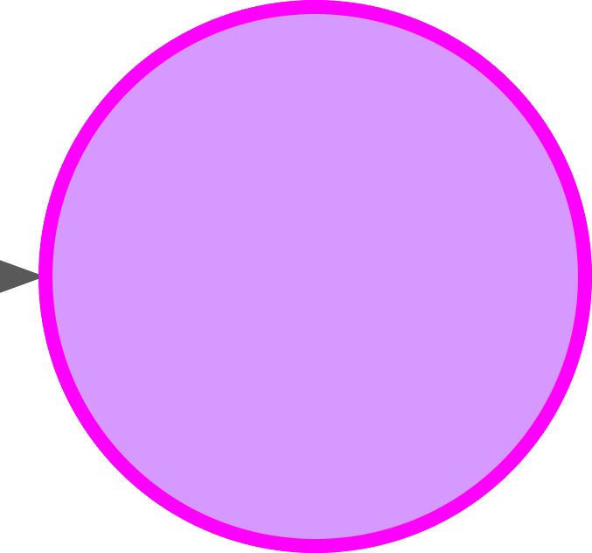
LLM fine-tuning process
Model
Model
Pre-trained LLM
Finetunned LLM

Slide 24
Fine-tuning on a single task

Slide 25

Fine-tuning on a single task
Model
Single-task training dataset,
e.g. summarization
Model
Pre-trained LLM
Summarize the following text:
[EXAMPLE TEXT] [EXAMPLE COMPLETION]
…
Instruct LLM
Summarize the following text:
[EXAMPLE TEXT] [EXAMPLE COMPLETION]
…
Summarize the following text:
[EXAMPLE TEXT] [EXAMPLE COMPLETION]
…
Summarize the following text:
[EXAMPLE TEXT] [EXAMPLE COMPLETION]
…
Often, only 500-1000 examples needed to fine-tune a single task

Slide 26
Catastrophic forgetting
Fine-tuning can significantly increase the performance of a model on a specific task…
Before fine-tuning
Prompt
Model
Completion
Classify this review: I loved this DVD!
Sentiment:
Classify this review: I loved this DVD!
Sentiment: eived a very nice book review
LLM

Slide 27
Catastrophic forgetting
Fine-tuning can significantly increase the performance of a model on a specific task…
After fine-tuning
Prompt
Model
Completion
Classify this review: I loved this DVD!
Sentiment:
Classify this review: I loved this DVD!
Sentiment: POSITIVE
LLM

Slide 28
Catastrophic forgetting
…but can lead to reduction in ability on other tasks
Before fine-tuning
Prompt
Model
Completion
What is the name of the cat?
Charlie the cat roamed the garden at night.
What is the name of the cat?
Charlie the cat roamed the garden at night.
Charlie
LLM

Slide 29
Catastrophic forgetting
…but can lead to reduction in ability on other tasks
After fine-tuning
Prompt
Model
Completion
What is the name of the cat?
Charlie the cat roamed the garden at night.
What is the name of the cat?
Charlie the cat roamed the garden at night.
The garden was positive.
LLM

Slide 30
How to avoid catastrophic forgetting
First note that you might not have to!
Fine-tune on multiple tasks at the same time
Consider Parameter Efficient Fine-tuning (PEFT)

Slide 31
Multi-task, instruction fine-tuning

Slide 32
Multi-task, instruction fine-tuning
Model
Instruction fine-tune on many tasks
Summarize the following text:
Pre-trained LLM
Rate this review:
Translate into Python code:
Identify the places:
…
[EXAMPLE TEXT] [EXAMPLE COMPLETION]

Slide 33

Multi-task, instruction fine-tuning
Model
Instruction fine-tune on many tasks
Model
Summarize the following text:
Pre-trained LLM
Instruct LLM
Rate this review:
Translate into Python code:
Identify the places:
…
Many examples of each needed for training
[EXAMPLE TEXT] [EXAMPLE COMPLETION]

Slide 34

Instruction fine-tuning with FLAN
FLAN models refer to a specific set of instructions used to perform instruction fine-tuning
“The metaphorical dessert to the main course of pretraining”
FLAN

Slide 35



Instruction fine-tuning with FLAN
FLAN models refer to a specific set of instructions used to perform instruction fine-tuning
T5
FLAN-T5
T5
FLAN
(Fine-tuned LAnguage Net)
PALM
FLAN-PALM
PALM

Slide 36
FLAN-T5: Fine-tuned version of pre-trained T5 model
FLAN-T5 is a great, general purpose, instruct model
T0-SF
Muffin
CoT (reasoning)
Natural Instructions
Commonsense Reasoning,
Question Generation,
Closed-book QA,
Adversarial QA,
Extractive QA
…
Natural language inference,
Code instruction gen,
Code repair
Dialog context generation,
Summarization (SAMSum)
…
Arithmetic reasoning,
Commonsense reasoning
Explanation generation,
Sentence composition,
Implicit reasoning,
…
Cause effect classification,
Commonsense reasoning,
Named Entity Recognition,
Toxic Language Detection,
Question answering
…
55 Datasets
14 Categories 193 Tasks
69 Datasets
27 Categories 80 Tasks
9 Datasets
1 Category 9 Tasks
372 Datasets
108 Categories 1554 Tasks
Source: Chung et al. 2022, “Scaling Instruction-Finetuned Language Models”

Slide 37
FLAN-T5: Fine-tuned version of pre-trained T5 model
FLAN-T5 is a great, general purpose, instruct model
T0-SF
Muffin
CoT (reasoning)
Natural Instructions
Commonsense Reasoning,
Question Generation,
Closed-book QA,
Adversarial QA,
Extractive QA
…
Natural language inference,
Code instruction gen,
Code repair
Dialog context generation,
Arithmetic reasoning,
Commonsense reasoning
Explanation generation,
Sentence composition,
Implicit reasoning,
…
Cause effect classification,
Commonsense reasoning,
Named Entity Recognition,
Toxic Language Detection,
Question answering
…
- Summarization (SAMSum)
…
55 Datasets
14 Categories 193 Tasks
69 Datasets
27 Categories 80 Tasks
9 Datasets
1 Category 9 Tasks
372 Datasets
108 Categories 1554 Tasks
Source: Chung et al. 2022, “Scaling Instruction-Finetuned Language Models”

Slide 38
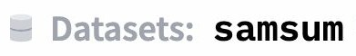
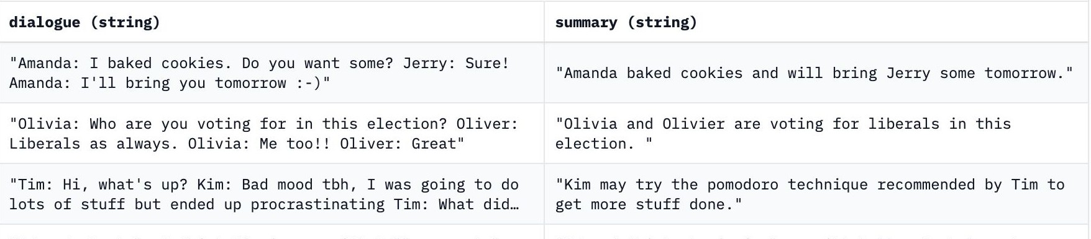
SAMSum: A dialogue dataset
Sample prompt training dataset (samsum) to fine-tune FLAN-T5 from pretrained T5
Source: https://huggingface.co/datasets/samsum, https://github.com/google-research/FLAN/blob/2c79a31/flan/v2/templates.py#L3285

Slide 39
Sample FLAN-T5 prompt templates
"samsum": [
("{dialogue}\n\Briefly summarize that dialogue.", "{summary}"),
("Here is a dialogue:\n{dialogue}\n\nWrite a short summary!", "{summary}"),
("Dialogue:\n{dialogue}\n\nWhat is a summary of this dialogue?", "{summary}"),
("{dialogue}\n\nWhat was that dialogue about, in two sentences or less?", "{summary}"),
("Here is a dialogue:\n{dialogue}\n\nWhat were they talking about?", "{summary}"),
("Dialogue:\n{dialogue}\nWhat were the main points in that "
"conversation?", "{summary}"),
("Dialogue:\n{dialogue}\nWhat was "{summary}"), | going | on | in | that | conversation?",
]

Slide 40
Sample FLAN-T5 prompt templates
"samsum": [
("{dialogue}\n\Briefly summarize that dialogue.", "{summary}"), ("Here is a dialogue:\n{dialogue}\n\nWrite a short summary!", "{summary}"),
("Dialogue:\n{dialogue}\n\nWhat is a summary of this dialogue?", "{summary}"),
("{dialogue}\n\nWhat was that dialogue about, in two sentences or less?", "{summary}"),
("Here is a dialogue:\n{dialogue}\n\nWhat were they talking about?", "{summary}"),
("Dialogue:\n{dialogue}\nWhat were the main points in that "
"conversation?", "{summary}"),
("Dialogue:\n{dialogue}\nWhat was | going | on | in | that | conversation?",
"{summary}"),
]

Slide 41
Improving FLAN-T5’s summarization capabilities
ShopBot
Hi there! How can I help you today?
I need to return a pair of jeans that I purchased
Of course, I’d be happy to help you. When did you buy your item?
T
Two weeks ago.
T

Slide 42
Improving FLAN-T5’s summarization capabilities
ShopBot
Hi there! How can I help you today?
Goal: Summarize conversations to identify actions to take
I need to return a pair of jeans that I purchased
Of course, I’d be happy to help you. When did you buy your item?
T
Two weeks ago.
T

Slide 43
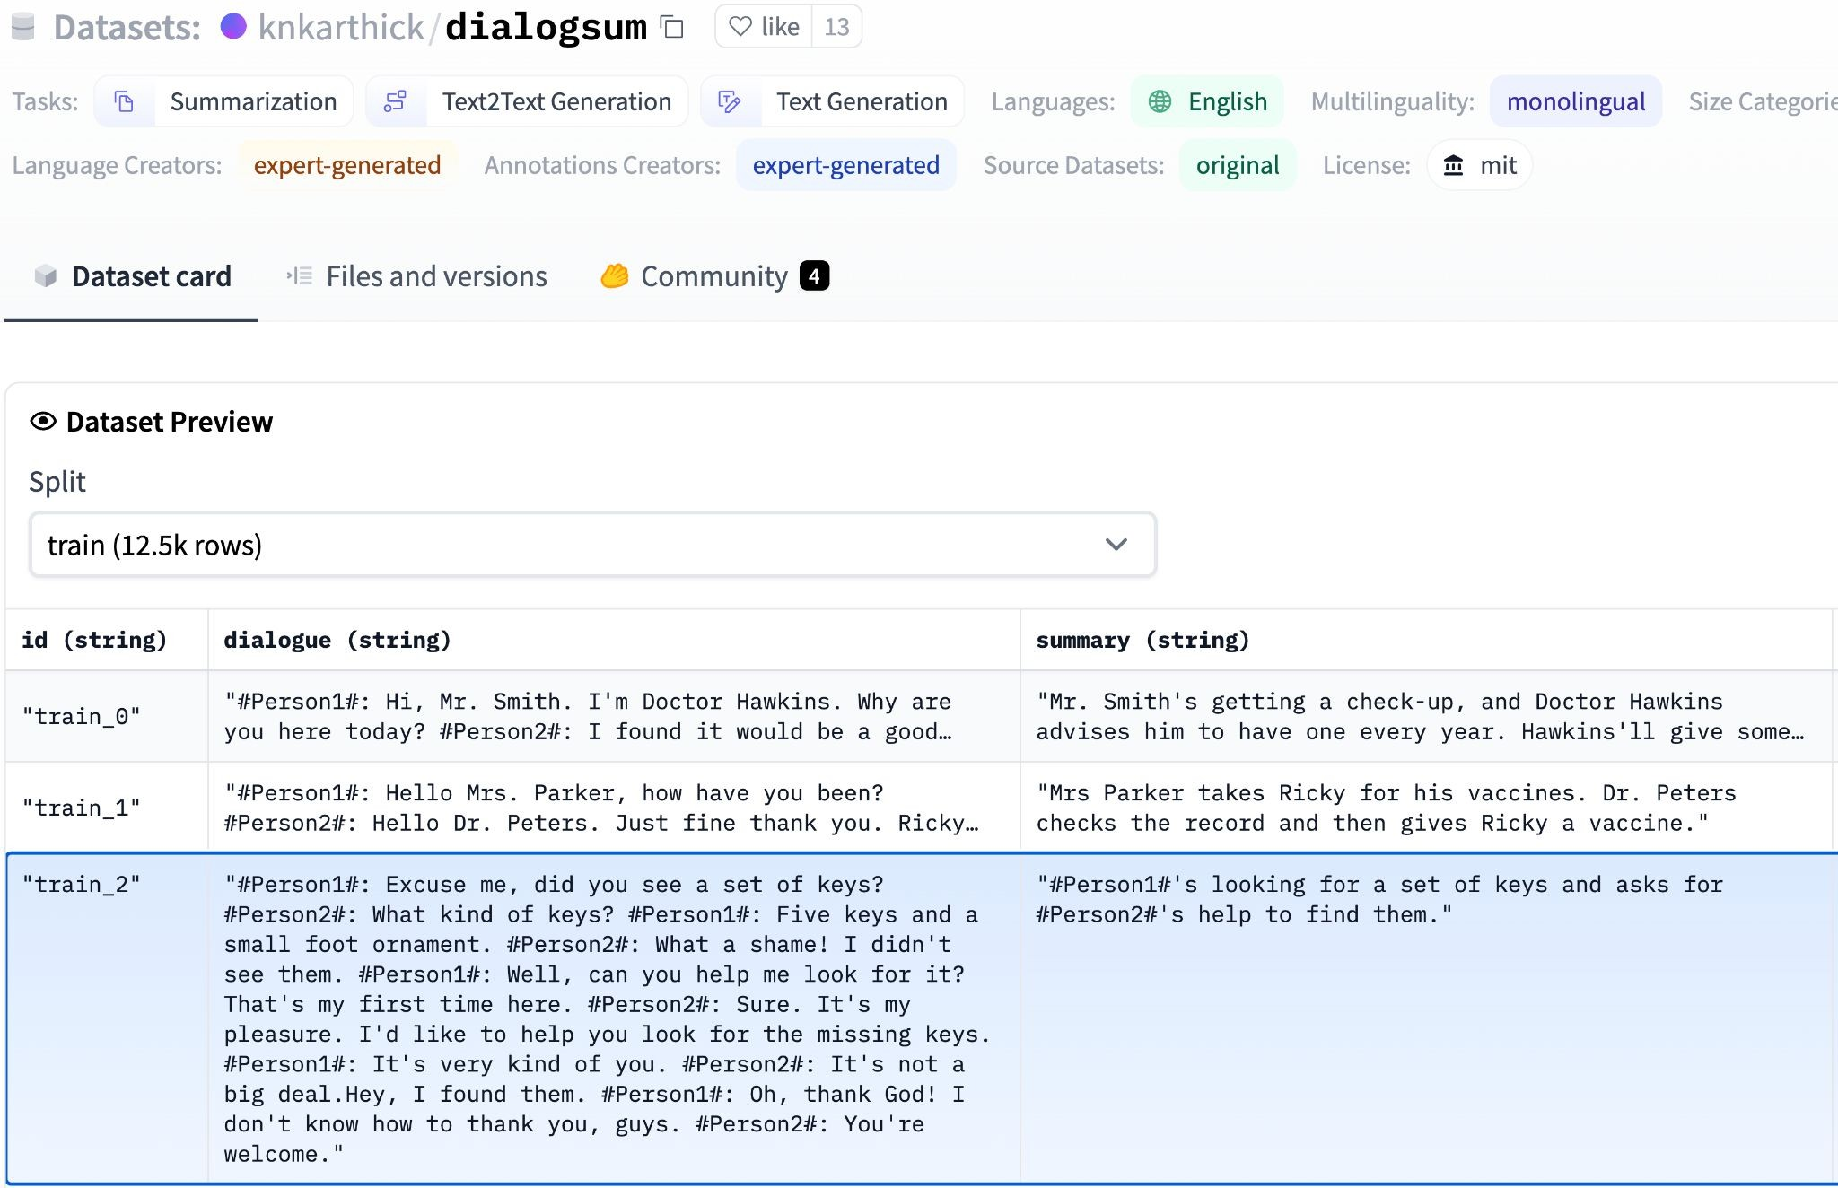
Improving FLAN-T5’s summarization capabilities
Further fine-tune FLAN-T5 with a domain-specific instruction dataset (dialogsum)

Slide 44
Example support-dialog summarization
Prompt (created from template)
Summarize the following conversation.
Tommy: Hello. My name is Tommy Sandals, I have a reservation. Mike: May I see some identification, sir, please?
Tommy: Sure. Here you go.
Mike: Thank you so much. Have you got a credit card, Mr. Sandals?
Tommy: I sure do.
Mike: Thank you, sir. You'll be in room 507, nonsmoking, queen bed.
Tommy: That's great, thank you! Mike: Enjoy your stay!
Source: https://huggingface.co/datasets/knkarthick/dialogsum/viewer/knkarthick--dialogsum/

Slide 45
Summary before fine-tuning FLAN-T5 with our dataset
Prompt (created from template)
Model
Completion (Summary)
Summarize the following conversation.
Tommy: Hello. My name is Tommy Sandals, I have a reservation.
Mike: May I see some
...
...
...
Tommy: That's great, thank you!
Mike: Enjoy your stay!
Tommy Sandals has a reservation for a room at the Venetian Hotel in Las Vegas.
FLAN-T5
Adequate completion, but does not match human baseline.
Human baseline summary:
Tommy Sandals has got a reservation. Mike asks for his identification and credit card and helps his check-in.

Slide 46
Summary before fine-tuning FLAN-T5 with our dataset
Prompt (created from template)
Model
Completion (Summary)
Summarize the following conversation.
Tommy: Hello. My name is Tommy Sandals, I have a reservation.
Mike: May I see some
...
...
...
Tommy: That's great, thank you!
Mike: Enjoy your stay!
Tommy Sandals has a reservation
for a room at the
Venetian
FLAN-T5
Hotel in Las Vegas.
Adequate completion, but does not match human baseline.
Human baseline summary:
Tommy Sandals has got a reservation. Mike asks for his identification and credit card and helps his check-in.

Slide 47
Summary before fine-tuning FLAN-T5 with our dataset
Prompt (created from template)
Model
Completion (Summary)
Summarize the following conversation.
Tommy: Hello. My name is Tommy Sandals, I have a reservation.
Mike: May I see some
...
...
...
Tommy: That's great, thank you!
Mike: Enjoy your stay!
Tommy Sandals has a reservation for a room at the Venetian
FLAN-T5
Hotel in
Las Vegas.
Adequate completion, but does not match human baseline.
Human baseline summary:
Tommy Sandals has got a reservation. Mike asks for his identification and credit card and helps his check-in.

Slide 48
Summary after fine-tuning FLAN-T5 with our dataset
Prompt (created from template)
Model
Completion (Summary)
Summarize the following conversation.
Tommy: Hello. My name is Tommy Sandals, I have a reservation.
Mike: May I see some
...
...
...
Tommy: That's great, thank you!
Mike: Enjoy your stay!
Tommy Sandals has a reservation and checks in showing his ID and credit card. Mike helps him to check in and approves his reservation.
FLAN-T5
(Fine-tuned)
Better summary, more-closely matches human baseline.

Slide 49
Fine-tuning with your own data
ShopBot
Hi there! How can I help you today?
I need to return a pair of jeans that I purchased
Of course, I’d be happy to help you. When did you buy your item?
T
Two weeks ago.
T

Slide 50
Model evaluation metrics

Slide 51
LLM Evaluation - Challenges
Correct Predictions
Accuracy =
Total Predictions

Slide 52



LLM Evaluation - Challenges
“Mike really loves drinking tea.”
“Mike adores sipping tea.”
=
=
“Mike does not drink coffee.”
“Mike does drink coffee.”

Slide 53
LLM Evaluation – Metrics: Task Specific
BLEU SCORE
ROUGE
Used for text summarization
Compares a summary to one or more reference summaries
Used for text translation
Compares to human-generated translations

Slide 54
LLM Evaluation - Metrics - Terminology
n-gram
The dog lay on the rug as I sipped a cup of tea. bigram unigram

Slide 55
LLM Evaluation - Metrics - ROUGE-1
Reference (human):
It is cold outside.
ROUGE-1
Recall
unigram matches unigrams in reference
4
4
=
=
= 1.0
Generated output:
It is very cold outside.
ROUGE-1
Precision:
unigram matches unigrams in output
4
5
=
=
= 0.8
ROUGE-1 F1:
₂ precision x recall
0.8
1.8
=
= 2
= 0.89
precision + recall

Slide 56
LLM Evaluation - Metrics - ROUGE-1
Reference (human):
It is cold outside.
ROUGE-1
Recall
unigram matches unigrams in reference
4
4
=
=
= 1.0
Generated output:
It is not cold outside.
ROUGE-1
Precision:
unigram matches unigrams in output
4
5
=
=
= 0.8
ROUGE-1 F1:
₂ precision x recall
0.8
1.8
=
= 2
= 0.89
precision + recall

Slide 57
LLM Evaluation - Metrics - ROUGE-2
Reference (human):
It is cold outside.
It is is cold cold outside
Generated output:
It is very cold outside.
It is is very very cold
cold outside

Slide 58
LLM Evaluation - Metrics - ROUGE-2
Reference (human):
It is cold outside.
It is is cold
cold outside
ROUGE-2
Recall:
bigram matches bigrams in reference
2
3
=
=
= 0.67
ROUGE-2
Precision:
bigram matches bigrams in output
2
4
=
=
= 0.5
Generated output:
It is very cold outside.
It is
very cold
is very
cold outside
₂ precision x recall
ROUGE-2 F1:
=
precision + recall
= 2 ^{0.335} = 0.57
1.17

Slide 59
LLM Evaluation - Metrics - ROUGE-L
Reference (human):
It is cold outside.
Generated output:
It is very cold outside.
Longest common subsequence (LCS):
It is
2
cold outside

Slide 60
LLM Evaluation - Metrics - ROUGE-L
Reference (human):
It is cold outside.
ROUGE-L
Recall:
LCS(Gen, Ref) unigrams in reference
2
4
=
=
= 0.5
Generated output:
It is very cold outside.
ROUGE-L
Precision:
LCS(Gen, Ref) unigrams in output
2
5
=
=
= 0.4
ROUGE-L F1:
₂ precision x recall
0.2
0.9
=
= 2
= 0.44
precision + recall

Slide 61
LLM Evaluation - Metrics - ROUGE-L
Reference (human):
It is cold outside.
ROUGE-L
Recall:
LCS(Gen, Ref) unigrams in reference
2
4
=
=
= 0.5
Generated output:
It is very cold outside.
ROUGE-L
Precision:
LCS(Gen, Ref) unigrams in output
2
5
=
=
= 0.4
LCS:
Longest common subsequence
ROUGE-L F1:
₂ precision x recall
0.2
0.9
=
= 2
= 0.44
precision + recall

Slide 62
LLM Evaluation - Metrics - ROUGE hacking
Reference (human):
It is cold outside.
Generated output:
cold cold cold cold

Slide 63


LLM Evaluation - Metrics - ROUGE clipping
Reference (human):
It is cold outside.
Generated output:
cold cold cold cold
ROUGE-1
Precision
unigram matches unigrams in output
4
4
=
=
= 1.0
Modified precision
clip(unigram matches) unigrams in output
1
4
=
=
= 0.25
Generated output:
outside cold it is
Modified precision
clip(unigram matches) ₌
4
4
=
= 1.0
unigrams in output

Slide 64
LLM Evaluation - Metrics
BLEU SCORE
ROUGE
Used for text summarization
Compares a summary to one or more reference summaries
Used for text translation
Compares to human-generated translations

Slide 65
LLM Evaluation - Metrics - BLEU
BLEU metric = Avg(precision across range of n-gram sizes)
Reference (human):
I am very happy to say that I am drinking a warm cup of tea.
Generated output:
I am very happy that I am drinking a cup of tea. - BLEU 0.495
I am very happy that I am drinking a warm cup of tea. - BLEU 0.730 I am very happy to say that I am drinking a warm tea. - BLEU 0.798
I am very happy to say that I am drinking a warm cup of tea. - BLEU 1.000

Slide 66
LLM Evaluation - Metrics
BLEU SCORE
ROUGE
Used for text summarization
Compares a summary to one or more reference summaries
Used for text translation
Compares to human-generated translations

Slide 67
Benchmarks

Slide 68
Benchmarks for massive models
Massive Multitask Language Understanding (MMLU)
2021
Source: Hendrycks, 2021. “Measuring Massive Multitask Language Understanding”

Slide 69
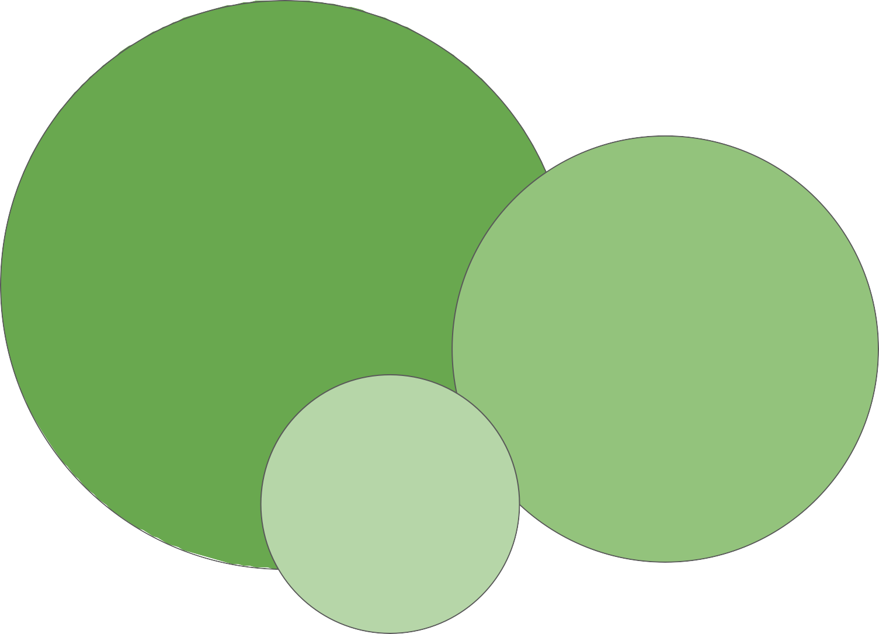
Benchmarks for massive models
Massive Multitask Language Understanding (MMLU)
BIG-bench Hard
BIG-bench
Lite
2021
2022
Source: Hendrycks, 2021. “Measuring Massive Multitask Language Understanding”
Source: Suzgun et al. 2022. “Challenging BIG-Bench tasks and whether chain-of-thought can solve them“

Slide 70
Benchmarks for massive models
Massive Multitask Language Understanding (MMLU)
BIG-bench Hard
BIG-bench
Lite
2021
2022
Source: Hendrycks, 2021. “Measuring Massive Multitask Language Understanding”
Source: Suzgun et al. 2022. “Challenging BIG-Bench tasks and whether chain-of-thought can solve them“

Slide 71
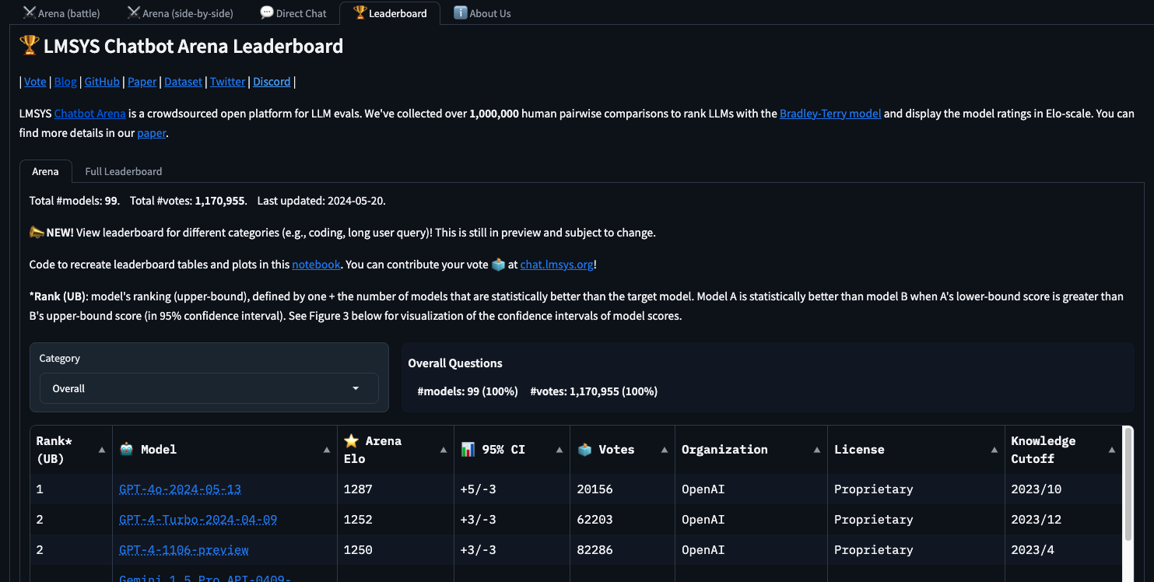
Benchmarks for massive models – Leaderboards URL

Slide 72
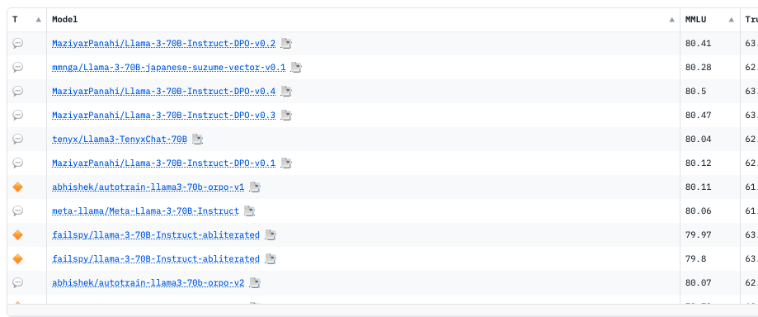
Benchmarks for OpenSource models – Leaderboards URL

Slide 73
Lets code this out?

Slide 74
PEFT and LoRa

Slide 75

Parameter- efficient
Fine-tuning (PEFT)

Slide 76

Full fine-tuning of large LLMs is challenging
Temp memory
Forward
Activations
LLM
12-20x
weights
Gradients
Optimizer states
Trainable
Weights

Slide 77
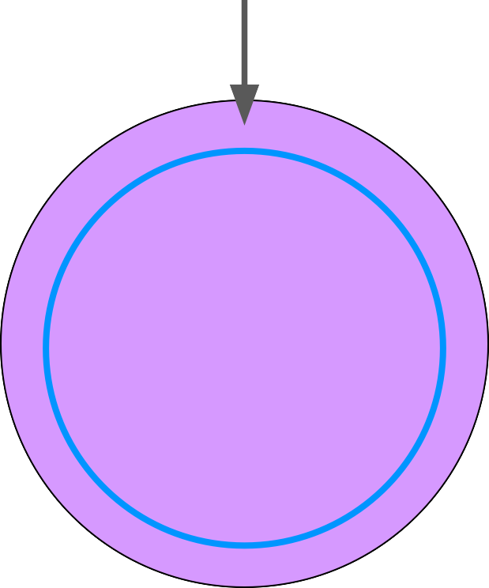
Parameter efficient fine-tuning (PEFT)
Small number of trainable layers
LLM
❄
LLM with most layers frozen

Slide 78

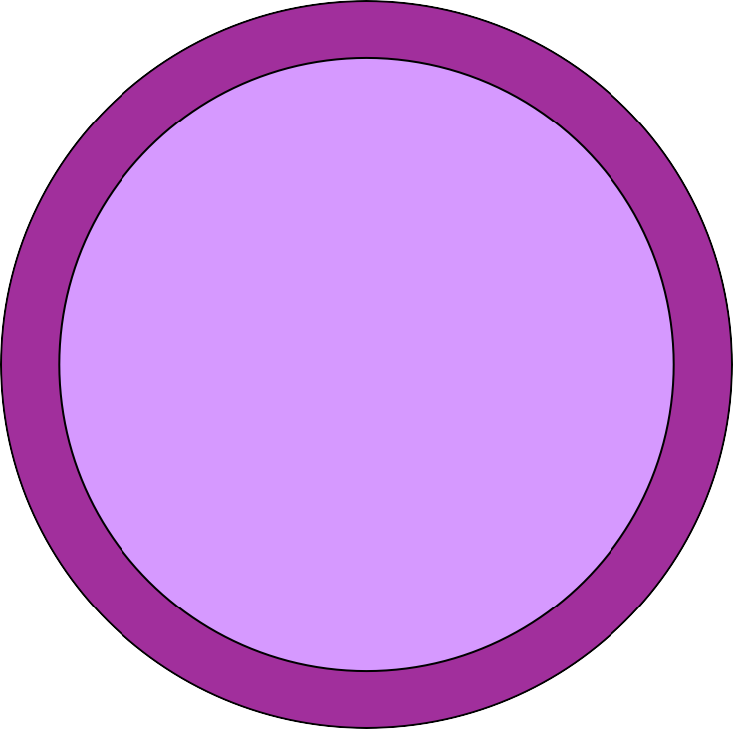
Parameter efficient fine-tuning (PEFT)
New trainable
layers
Less prone to catastrophic forgetting
LLLLMM
❄
Other components
Trainable weights
❄
Frozen Weights
LLM with additional layers for PEFT

Slide 79





Full fine-tuning creates full copy of original LLM per task
GBs
QA LLM
QA fine tune
GBs
GBs
Summarize fine tune
Summarize LLM
LLM
GBs
Generate fine tune
Generate LLM

Slide 80


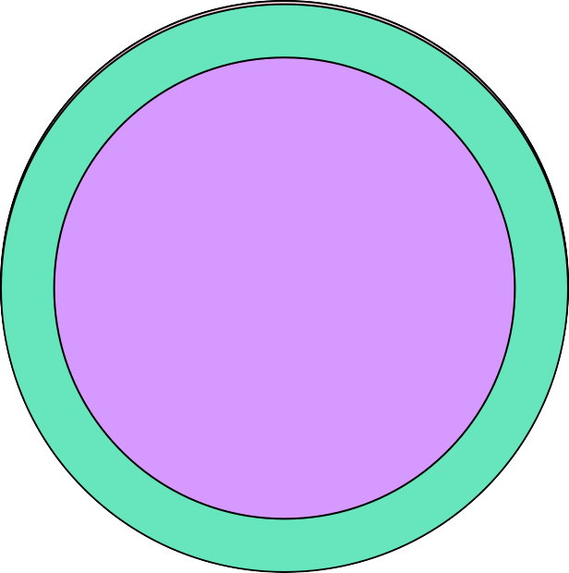

PEFT fine-tuning saves space and is flexible
PEFT weights
QA PEFT
MBs
GBs
Summarize PEFT
LLM
MBs
Generate PEFT
MBs

Slide 81

PEFT Trade-offs
Parameter Efficiency
Memory Efficiency
Training Speed
Model Performance
Inference Costs

Slide 82
PEFT methods
Selective
Reparameterization
Select subset of initial LLM parameters to fine-tune
Reparameterize model weights using a low-rank representation
Source: Lialin et al. 2023, “Scaling Down to Scale Up: A Guide to Parameter-Efficient Fine-Tuning”,

Slide 83
PEFT methods
Selective
Select subset of initial LLM parameters to fine-tune
Reparameterization
Additive
Reparameterize model weights using a low-rank representation
LoRA
Add trainable layers or parameters to model
Adapters
Soft Prompts
Prompt Tuning
Source: Lialin et al. 2023, “Scaling Down to Scale Up: A Guide to Parameter-Efficient Fine-Tuning”,

Slide 84
Low-Rank Adaptation of Large Language Models (LoRA)

Slide 85

Transformers: recap
Output
Softmax output
J'aime l'apprentissage automatique
Decoder
Encoder
2345
3425
3853
Embedding
Embedding
Inputs

Slide 86
Transformers: recap
Output
Softmax output
Feed forward network
Feed forward network
Decoder
Encoder
Self-attention
Self-attention
2345
3425
3853
Embedding
Embedding
Inputs

Slide 87
LoRA: Low Rank Adaption of LLMs
Freeze most of the original LLM weights.
Encoder
Self-attention
Weights applied to embedding vectors
❄
Embedding

Slide 88
LoRA: Low Rank Adaption of LLMs
Freeze most of the original LLM weights.
Inject 2 rank decomposition matrices
Train the weights of the smaller matrices
Encoder
Self-attention
❄
+
Rank r is small dimension, typically 4, 8 … 64
Embedding

Slide 89
LoRA: Low Rank Adaption of LLMs
Freeze most of the original LLM weights.
Inject 2 rank decomposition matrices
Train the weights of the smaller matrices
Encoder
Self-attention
❄
+
Steps to update model for inference
1. Matrix multiply the low rank matrices
B
*
A
=
A x B
Embedding
2. Add to original weights
+
❄
A x B

Slide 90
LoRA: Low Rank Adaption of LLMs
Freeze most of the original LLM weights.
Inject 2 rank decomposition matrices
Train the weights of the smaller matrices
Encoder
Self-attention
Updated weights
❄
+
A x B
Steps to update model for inference:
1. Matrix multiply the low rank matrices
B
*
A
=
A x B
Embedding
2. Add to original weights
+
❄
A x B

Slide 91
Concrete example using base Transformer as reference
Use the base Transformer model presented by Vaswani et al. 2017:
Transformer weights have dimensions d x k = 512 x 64
So 512 x 64 = 32,768 trainable parameters
512
64
In LoRA with rank r = 8:
A has dimensions r x k = 8 x 64 = 512 parameters
B has dimension d x r = 512 x 8 = 4,096 trainable parameters
8
64
512
86% reduction in parameters to train!
8

Slide 92
LoRA: Low Rank Adaption of LLMs
Train different rank decomposition matrices for different tasks
Update weights before inference
Encoder
Self-attention
Weights applied to embedding vectors
Task A
* =
+
❄
Embedding

Slide 93
LoRA: Low Rank Adaption of LLMs
Train different rank decomposition matrices for different tasks
Update weights before inference
Encoder
Self-attention
Updated
❄
Task A
+
* =
weights for
task A
+
❄
Embedding
Task B
*
=
+
❄

Slide 94
LoRA: Low Rank Adaption of LLMs
Train different rank decomposition matrices for different tasks
Update weights before inference
Encoder
Self-attention
Updated
❄
Task A
+
* =
weights for
task B
+
❄
Embedding
Task B
*
=
+
❄

Slide 95

Sample ROUGE metrics for full vs. LoRA fine-tuning
Base model ROUGE
Full fine-tune ROUGE
FLAN-T5
Dialog summarization
flan_t5_base
{‘rouge1’: 0.2334,
‘rouge2’: 0.0760,
‘rougeL’: 0.2014,
‘rougeLsum’: 0.2015}
Baseline score

Slide 96
Sample ROUGE metrics for full vs. LoRA fine-tuning
Base model ROUGE
Full fine-tune ROUGE
LoRA fine tune ROUGE
+80.63%
-3.20%
flan_t5_base_instruct_full
{‘rouge1’: 0.4216,
flan_t5_base_instruct_lora
FLAN-T5
Dialog summarization
‘rouge2’: 0.1804,
‘rougeL’: 0.3384,
‘rougeLsum’: 0.3384}
{‘rouge1’: 0.4081,
‘rouge2’: 0.1633,
‘rougeL’: 0.3251,
‘rougeLsum’: 0.3249}
flan_t5_base
{‘rouge1’: 0.2334,
‘rouge2’: 0.0760,
‘rougeL’: 0.2014,
‘rougeLsum’: 0.2015}
Baseline score

Slide 97

Computational challenges

Slide 98
Approximate GPU RAM needed to store 1B parameters
1 parameter = 4 bytes (32-bit float) 1B parameters = 4 x 10⁹ bytes = 4GB
4GB @ 32-bit full precision
Sources: https://huggingface.co/docs/transformers/v4.20.1/en/perf_train_gpu_one#anatomy-of-models-memory, https://github.com/facebookresearch/bitsandbytes

Slide 99
Additional GPU RAM needed to train 1B parameters
 | Bytes per parameter
Model Parameters (Weights) | 4 bytes per parameter
Adam optimizer (2 states) +8 bytes per parameter
Gradients +4 bytes per parameter
~20 extra bytes per parameter
Activations and +8 bytes per parameter (high-end estimate)
temp memory (variable size)
^{TOTAL} =4 bytes per parameter
+20 extra bytes per parameter
Sources: https://huggingface.co/docs/transformers/v4.20.1/en/perf_train_gpu_one#anatomy-of-models-memory, https://github.com/facebookresearch/bitsandbytes

Slide 100
Approximate GPU RAM needed to train 1B-params
Memory needed to store model Memory needed to train model
80GB @ 32-bit full precision
4GB @ 32-bit full precision

Slide 101


Quantization
MIN
_{~3e}-38
0.0
MAX
~3e³⁸
FP32
32-bit floating point
Range:
From ~3e⁻³⁸ to ~3e³⁸
FP16 | BFLOAT16 | INT8
16-bit floating point | 8-bit integer
?
0
?

Slide 102
Quantization: FP32
Let's store Pi: 3.141592
MIN
_{~3e}-38
0.0
MAX
~3e³⁸
FP32
0 10000000 10010010000111111011000
X
3.1415920257568359375
Real value of Pi: 3.1415926535897932384
Sign
1 bit
Exponent
8 bits
Fraction
23 bits
Mantissa / Significand
= Precision
0

Slide 103
Quantization: FP16
Let's store Pi: 3.141592
MIN
_{~3e}-38
0.0
MAX
~3e³⁸
FP32 4 bytes memory
0 10000000 10010010000111111011000
X
3.1415920257568359375
Sign
1 bit
Exponent
8 bits
Fraction
23 bits
3.140625
FP16 2 bytes memory
0 10000 1001001000
X
0
MIN
-65504
MAX 65504
Sign
1 bit
Exponent
5 bits
Fraction
10 bits

Slide 104





Quantization: BFLOAT16
Let's store Pi: 3.141592
MIN
_{~3e}-38
0.0
MAX
~3e³⁸
FP32 4 bytes memory
0 10000000 10010010000111111011000
X
3.1415920257568359375
Sign
1 bit
Exponent
8 bits
Fraction
23 bits
3.140625
BFLOAT16 | BF16 2 bytes memory
0 10000000 1001001
X
MIN
_{~3e}-38
0
MAX
~3e³⁸
"Truncated FP32"
Sign
1 bit
Exponent
8 bits
Fraction
7 bits

Slide 105


Quantization: INT8
Let's store Pi: 3.141592
MIN
_{~3e}-38
0.0
MAX
~3e³⁸
FP32 4 bytes memory
0 10000000 10010010000111111011000
X
3.1415920257568359375
Sign
1 bit
Exponent
8 bits
Fraction
23 bits
3
X
INT8 1 byte memory
0 0000011
MIN
-128
0
MAX 127
Sign 1 bit
Fraction 7 bits

Slide 106
Quantization: Summary
 | Bits | Exponent | Fraction | Memory needed to store one value
FP32 | 32 | 8 | 23 | 4 bytes
FP16 | 16 | 5 | 10 | 2 bytes
BFLOAT16 | 16 | 8 | 7 | 2 bytes
INT8 | 8 | –/– | 7 | 1 byte
Flan T5
Reduce required memory to store and train models
Projects original 32-bit floating point numbers into lower precision spaces
Quantization-aware training (QAT) learns the quantization scaling factors during training
BFLOAT16 is a popular choice

Slide 107
Approximate GPU RAM needed to store 1B parameters
Full- precision model
16-bit quantized model
8-bit quantized model
4GB @ 32-bit full precision
2GB @ 16-bit half precision
1GB @ 8-bit precision
Sources: https://huggingface.co/docs/transformers/v4.20.1/en/perf_train_gpu_one#anatomy-of-models-memory, https://github.com/facebookresearch/bitsandbytes

Slide 108
Approximate GPU RAM needed to train 1B-params
80GB @ 32-bit full precision
40GB @ 16-bit half precision
20GB @ 8-bit precision
80GB is the maximum memory for the Nvidia A100 GPU, so to keep the model on a single GPU, you need to use 16-bit or 8-bit quantization.
Sources: https://huggingface.co/docs/transformers/v4.20.1/en/perf_train_gpu_one#anatomy-of-models-memory, https://github.com/facebookresearch/bitsandbytes

Slide 109
GPU RAM needed to train larger models
1B param model
175B param model
500B param model
14,000 GB @ 32-bit
full precision
40,000 GB @ 32-bit
full precision

Slide 110
GPU RAM needed to train larger models
As model sizes get larger, you will
500B param model
need to split your model across multiple GPUs for training
40,000 GB @ 32-bit
full precision
175B param model
14,000 GB @ 32-bit
full precision
1B param model

Slide 111
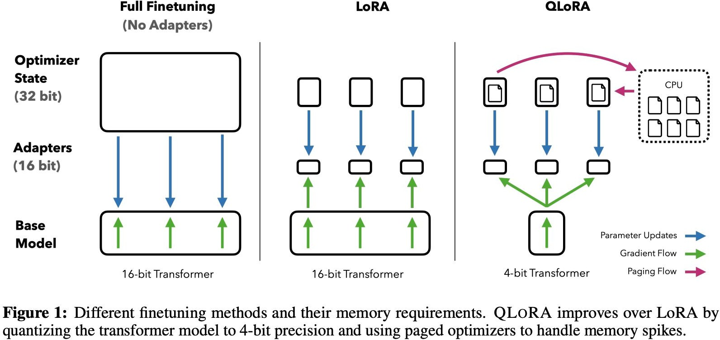
QLoRA: Quantized LoRA
Introduces 4-bit NormalFloat (nf4) data type for 4-bit quantization
Supports double-quantization to reduce memory ~0.4 bits per parameter (~3 GB for a 65B model)
Unified GPU-CPU memory management reduces GPU memory usage
LoRA adapters at every layer - not just attention layers
Minimizes accuracy trade-off
Source: Dettmers et al. 2023, “QLoRA: Efficient Finetuning of Quantized LLMs”

